Slide 1
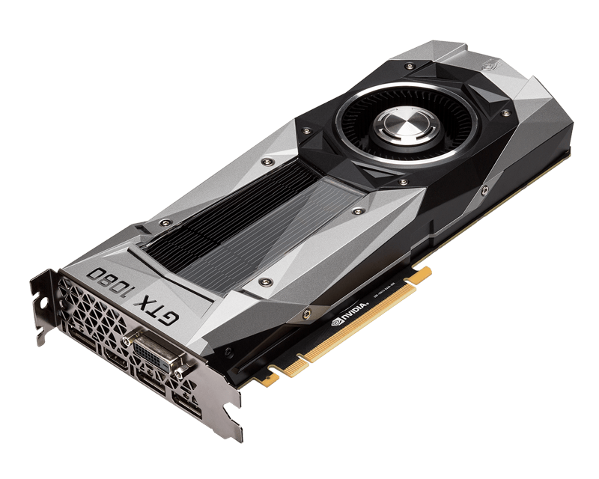
GPU Market
$$$
Group Members:
James Hammer
Jimmy Hammy
Jimmother Hamthter
Jamble Hamble
1

Slide 2
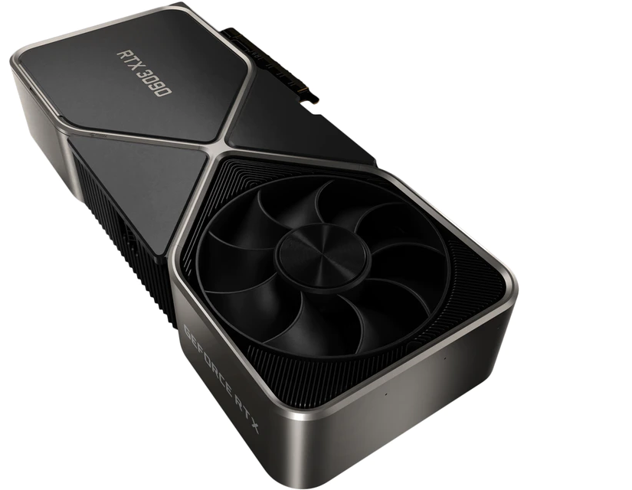
What is a GPU
Graphics Processing Unit
GPGPU - General Purpose GPU
Good for Video Games
Good for vectorizable High Performance computation such as AI or Video Rendering
Let’s be real, most people want them for games.
2

Slide 3
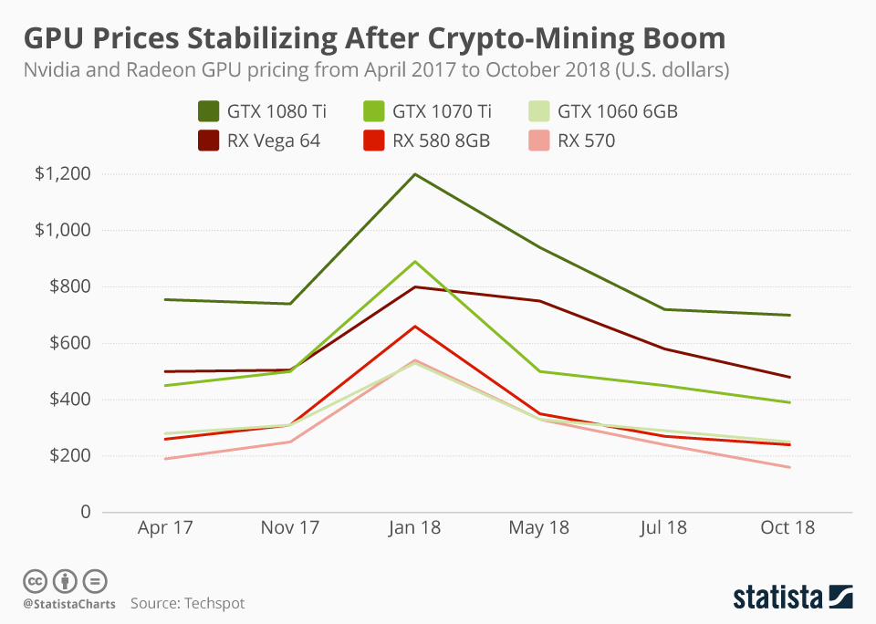
GPU Prices
Historically trading prices are close to MSRP long term
Prices drop as product ages
Demand is adequately met
Influenced by outside factors, but rebounds quickly to stable MSRP
3

Slide 4

Covid
Somehow economy hasn’t crashed
Work from Home Policies
All tech has become more expensive
GPU’s hit particularly hard because of multiple factors, but the biggest is probably Covid.
4

Slide 5
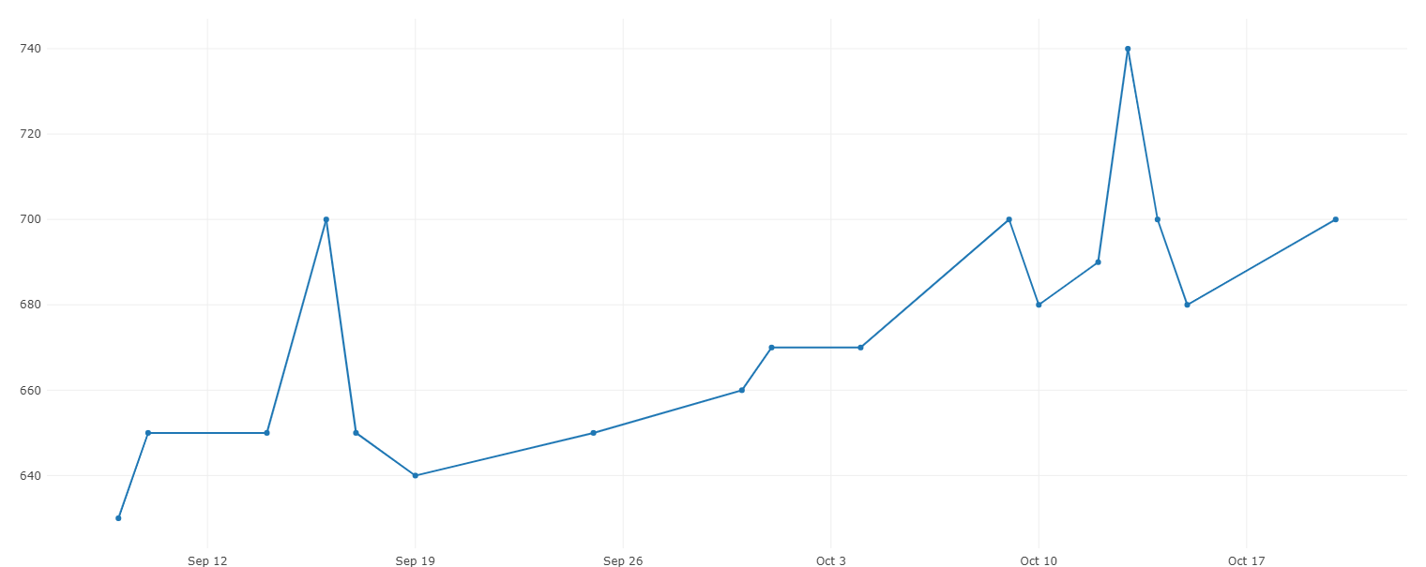
Recent GPU Prices
Well above MSRP for many cards
Many potential factors
The worst the GPU market has been
Newer cards are affected more
All cards have gone up
Even my 5 year old gtx 1070
5

Slide 6
How can we gain these insights?
AI?
The Past?
Finding Causations?
Finding Correlations!
Too Hard
What about it?
Impossible.
Ok fine I’ll give it a try.
6

Slide 7
We Need Data.
What Data?
Historical GPU Prices
Card Specs
Crypto Prices
Covid Cases
Software Releases
Google Trend Data
From Where?
Honey.com
cardsTechnica
Kaggle
Github
Kaggle
Google Trends
Data Type?
Time Series
Discrete Event
Time Series
Time Series
Discrete Event
Time Series
7

Slide 8
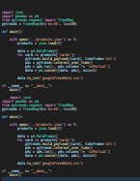
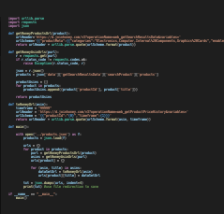
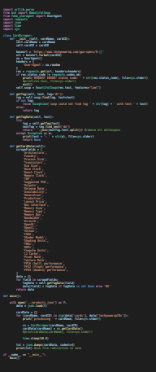




Getting the Data
Historical GPU Prices
Card Specs
Crypto Prices
Covid Cases
Software Releases
Google Trend Data
1200 GPUS
s
From Kaggle
From Github
From Kaggle
1200 trend datas
8

Slide 9
How much Data did we get?
Historical GPU Prices
Card Specs
Crypto Prices
Covid Cases
Software Releases
Google Trend Data
152 GPUS
36 specs
23 Crypto Coins
250 million cases
37 Video Games
152 trend data
7.7 Mb
9

Slide 10
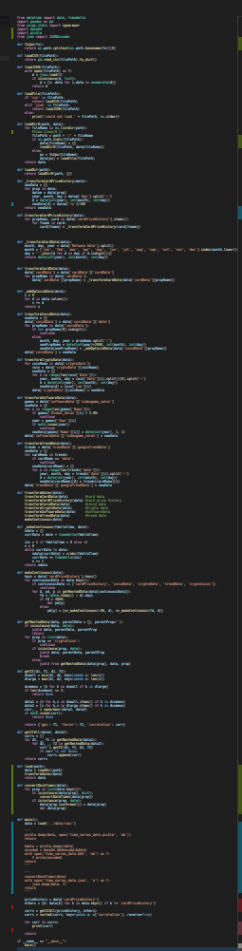
What do we do with all this data now?
Load all data into memory
Transform data into a standardized time series format
Save only the relevant time series transformed output in json format
Write it
Cut it
Paste it
Save it
Load it
Check it
Quick Rewrite It
Plug it
Play it
Burn it
Rip it
Drag it
Drop it
Zip
Unzip it
6.1 Mb
10

Slide 11
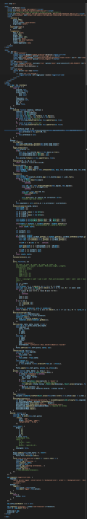
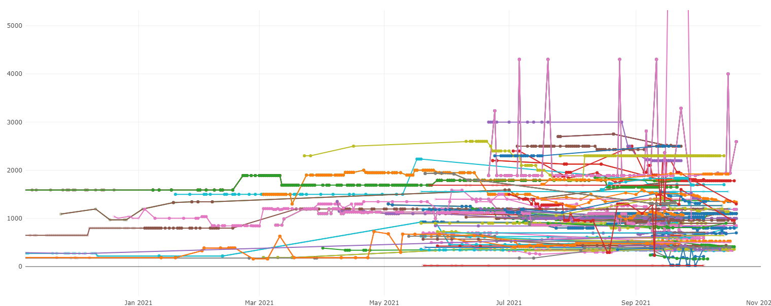
What do we do with all this data now?
Make a web-based viewing application
https://web.eecs.utk.edu/~jhammer3/fdac21/
Explore!
Perform Correlation Coefficient searches
Sort Results
Gain Insights!
11

Slide 12
DEMO!
12

Slide 13
